Slide 1


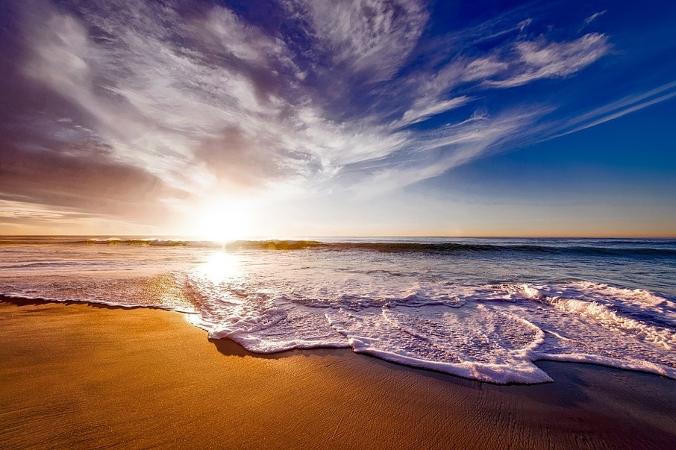
MIC Smart Beach by Bruce County
By Dr. Alex Smith
Sanjeev Kumar - Professor
Brunilda Xhaferllari – Project Manager
Rich Freeman – Faculty Menton
AI Team:
Janvi Patel
Fangji Chen
Scaria Ouseph Kurian
Notes:
Image: 12019 (2016) Ocean waves crashing on shore during daytime https://pixabay.com/photos/beach-sea-sunset-sun-sunlight-1751455/

Slide 2
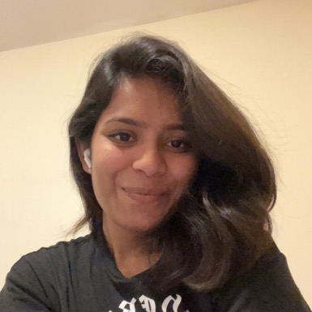
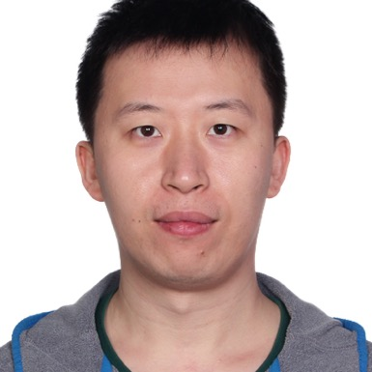
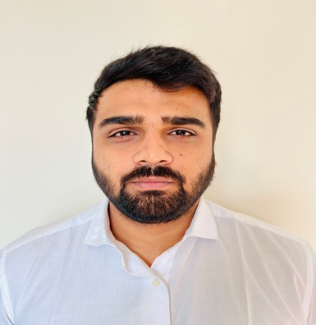

Our Team
Janvi
Patel
Scaria Ouseph Kurian
Fangji Chen
Project Lead / Communicator
Developer
Analyst

Slide 3

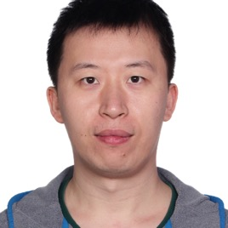
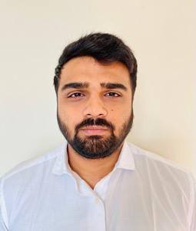
Who we are
I have a Bachelor of Computer Science degree from GTU. Prior to the Big Data Analysis program at Georgian College, I was a software developer. In terms of skills, I have high communication and organization with intermediate level experience in Python, Power BI, Machine Learning, and Deep Learning. I look forward to this project and our future weeks together.
I have a bachelor's degree in electronic information engineering and have 10 years of working experience in software engineering, data mining, and machine learning after graduating. I'm glad to work on this project and move forward with the group.
I have a Bachelor’s degree in computer science and a postgraduate program in Big Data Analytics and now I’m pursuing Artificial intelligence at Georgian college. I have an intermediate level experience in Power BI, Machine Learning, and Python. I’m glad to work on this project and move forward with this group.

Slide 4
Project Summary
The smart beach project is a three year pilot project that will provide swimmers with up-to-date information on water conditions.
The general project agenda is to use buoy(National oceanic and atmospheric administration) data and camera images to predict future water conditions.
There are 3 questions provided by MIC to the whole team of the which AI team will be working on the following question.
Predict the wave conditions and current visible in the camera images, as well the number and distribution of people on the beach and in the water.

Slide 5
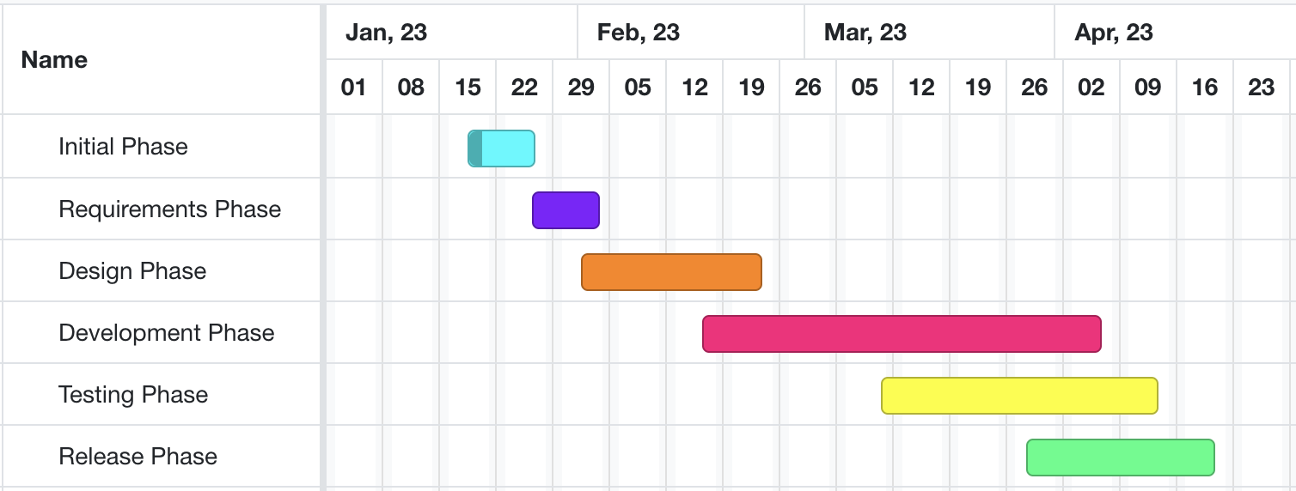
High-level GANTT Chart

Slide 6

Additional activities since last report
Issues/challenges
Predicted Image set were of closer range. While the originals are from far.
Work:
We choose YOLOv5 as a candidate and trained the model with the dataset we found from google as we introduced last week.
Candidate model research and selection: YOLOv5 ... Done
Prepare training images of Bruce Beach ... Block
Prepare labeleling training images from google ... done
YOLOv5 model training ... done
YOLOv5 model testing ... Done
Baseline preparing ... Done
Notes:
Padrinan, Miguel (n.d.). Email blocks on Gray Surface. Accessed on January 16th, 2023 from https://www.pexels.com/photo/email-blocks-on-gray-surface-1591062/

Slide 7
Communication plan:
Project: MIC at Bruce Beach
Choose the best reliable model to apply as an agent to count people onshore and inshore from camera images
Communication Goals: Keep group members informed of progress along the way and the results of the research
The progress of building the baseline
The progress of training the model
Content: discuss the research progress and challenges
Period: every two days
Methods: through Microsoft Teams Chat
Audience: required researchers and developers
Notes:
Olexa, Peter (n.d.) A Person Making a Schedule. Accessed on January 18th, 2023 from https://www.pexels.com/photo/a-person-making-a-schedule-14299948/

Slide 8
Individual Status Report - Janvi:
Found a dataset from the internet to work on.
Labeled images.
Worked on Training the images found on the rom internet.
Notes:
Olexa, Peter (n.d.) A Person Making a Schedule. Accessed on January 18th, 2023 from https://www.pexels.com/photo/a-person-making-a-schedule-14299948/

Slide 9
Individual Status Report - Scaria
Cleaned, pre-process, analyze and label the data.
Feature extracting which involves identifying extracting relevant features from the image.
Worked on the training images.

Slide 10
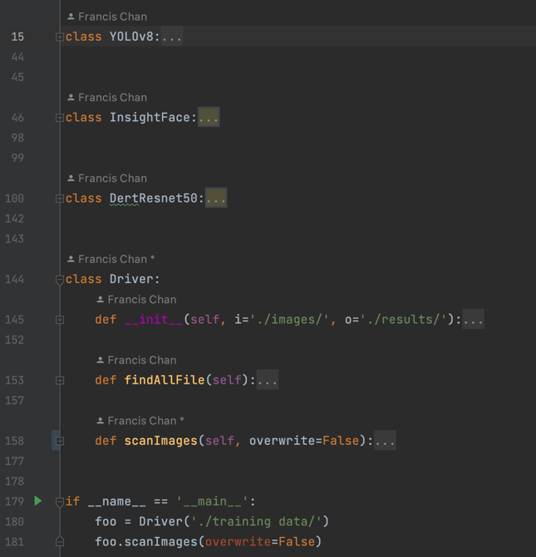
Individual Status Report - Fangji
Prepare validation images
Researching and choosing candidate models as a baseline
This baseline is going to be used to measure how well our YOLOv5 model performs compares to those pre-trained models.
Prepare development environments for these baseline models
Run baseline models and analyze the results for good cases and bad cases
To be Continued

Slide 11
Activities to be Completed before Next report:
Training model with labeled client data.
Start training and testing split.
Test the model tested and look for accuracy testing.
Notes:
Olexa, Peter (n.d.) A Person Making a Schedule. Accessed on January 18th, 2023 from https://www.pexels.com/photo/a-person-making-a-schedule-14299948/

Slide 12

Thank you!
Questions?
Notes:
Image: Leloo, The first (2022) https://www.pexels.com/photo/question-marks-on-paper-crafts-5428833/

